Slide 1

AI-CAD HOUSE BUILDER
A TOOL-USING LLM FRAMEWORK FOR NATURAL-LANGUAGE ARCHITECTURAL CAD
FINAL REVIEW PRESENTATION
TEAM MEMBERS
SHYAMSUNDAR KAMALAKANNAN
DHASARADHAN D
PRAJESHWARAN B
PROJECT GUIDE:
Dr.G.Revathy

Slide 2
AI-CAD House Builder
A tool-using LLM framework for natural-language architectural CAD
Notes:
Title slide. Academic prototype: natural-language-driven architectural CAD using a local LLM as planner.

Slide 3
The gap between idea and geometry
Core problems
Current workflow
1
High learning curve of professional CAD software
Idea
user requirement
2
Manual modelling and layout creation take time
CAD skills
commands + dimensions
3
Hard to turn a verbal idea into precise geometry
Manual model
2D / 3D construction
4
Repeated work when dimensions or rooms change
Revision
repeat operations
5
Unconstrained LLM output can be invalid geometry
Notes:
The gap between design ideas and usable CAD geometry.

Slide 4
A conversational CAD layer
1
Understand
2
Extract
3
Plan
Interpret the natural-language request.
Identify rooms, sizes and constraints.
The LLM selects structured CAD operations.
4
Validate
5
Build
6
Edit and walk
Check operations against geometry rules.
A deterministic engine creates the model.
Refine by hand or by AI, then explore in 3D.
DESIGN PRINCIPLE One persistent model drives editing, rendering and walkthrough.
Notes:
A conversational CAD layer in six steps.

Slide 5
What the project aims to achieve
Generate first designs from natural language
Convert requirements into structured geometry
1
2
Keep the LLM to planning, not raw geometry
Validate operations before execution
3
4
Real-time 2D and 3D visualisation
Support manual and AI-assisted editing
5
6
Run fully on local hardware
Evaluate with measured experiments
7
8
Notes:
Eight objectives.

Slide 6
Abstract
AI-CAD House Builder is a natural-language-driven architectural CAD prototype. A locally hosted LLM (Qwen 2.5 7B) acts as a planner that turns a user request into structured house data: walls, doors, windows, rooms and roof. A deterministic engine renders that data as an editable 2D plan and an interactive 3D scene, with cost estimation, electrical and plumbing layout, a first-person walkthrough and JSON, CSV and DXF export. The framework is designed to route model output through validated tool calls and a persistent semantic model, and to be evaluated against direct-generation baselines.
Prompt
Interpret
CAD objects
3D scene
Walk
Notes:
Abstract.

Slide 7
End-to-end pipeline
UNDERSTAND
EXECUTE
EXPERIENCE
1
Natural-language request
4
Tool selection
7
Persistent semantic model
2
Requirement extraction
5
Validation
8
2D / 3D visualisation
3
LLM planning
6
Deterministic geometry
9
User review and editing
Core loop: requirement, structured model, geometry, interaction
Notes:
Nine-step pipeline grouped into three phases.

Slide 8
From prompt to editable plan
INPUT
Living room
Kitchen
“2BHK single-floor house with living room, kitchen, 2 bedrooms, 1 bathroom.”
AI INTERPRETATION
Master bedroom
Bath
Bedroom 2
Plot size, room count and types, openings
STRUCTURED OUTPUT
Walls, doors, windows, rooms, roof
Schematic plan from structured room data
Notes:
Example conversion from a prompt to an editable plan. Plan drawn is schematic, based on the built-in layout generator.

Slide 9
System architecture
INPUT MODULE
AI PLANNING MODULE
TOOL & VALIDATION MODULE
PROMPT BAR
React + Vite :5173
REST API
FastAPI :8000 /generate /modify
LLM PLANNER
Qwen 2.5 7B, llama.cpp :8080
TOOL REGISTRY
structured CAD calls (planned)
VALIDATOR + RETRY
geometry rules (planned)
GEOMETRY ENGINE MODULE
MODEL & EXPERIENCE MODULE
NORMALIZER
single floor, drops bad openings
GEOMETRY ENGINE
deterministic walls, doors, roof
SEMANTIC MODEL
house JSON, one source of truth
2D / 3D VIEWER
Three.js / R3F, walkthrough
EDIT + EXPORT
inspector, cost, JSON CSV DXF
manual and AI edits update the model
Implemented
Planned
Fallback: built-in keyword generator if the local LLM is unavailable. Runs fully on local hardware.
Notes:
Three local services. Solid boxes exist in the code today; dashed amber boxes are the planned tool and validation layer from the paper. The backend currently calls Ollama; target is llama.cpp.

Slide 10
Focused on the complete design loop
1
2
3
4
Natural-language CAD
AI generation
Editable 2D / 3D
AI modification
Describe a house, no commands to learn
Rooms, walls and openings from one prompt
Select and adjust walls, doors, windows, roof
“Make the roof hip” style edits
5
6
7
8
Walkthrough
Services planner
Cost estimate
Save and export
First-person walk through the model
Electrical and plumbing fixtures
Editable INR rates, live subtotal
JSON, CSV, DXF, print or PDF
Notes:
Eight key features of the prototype.

Slide 11
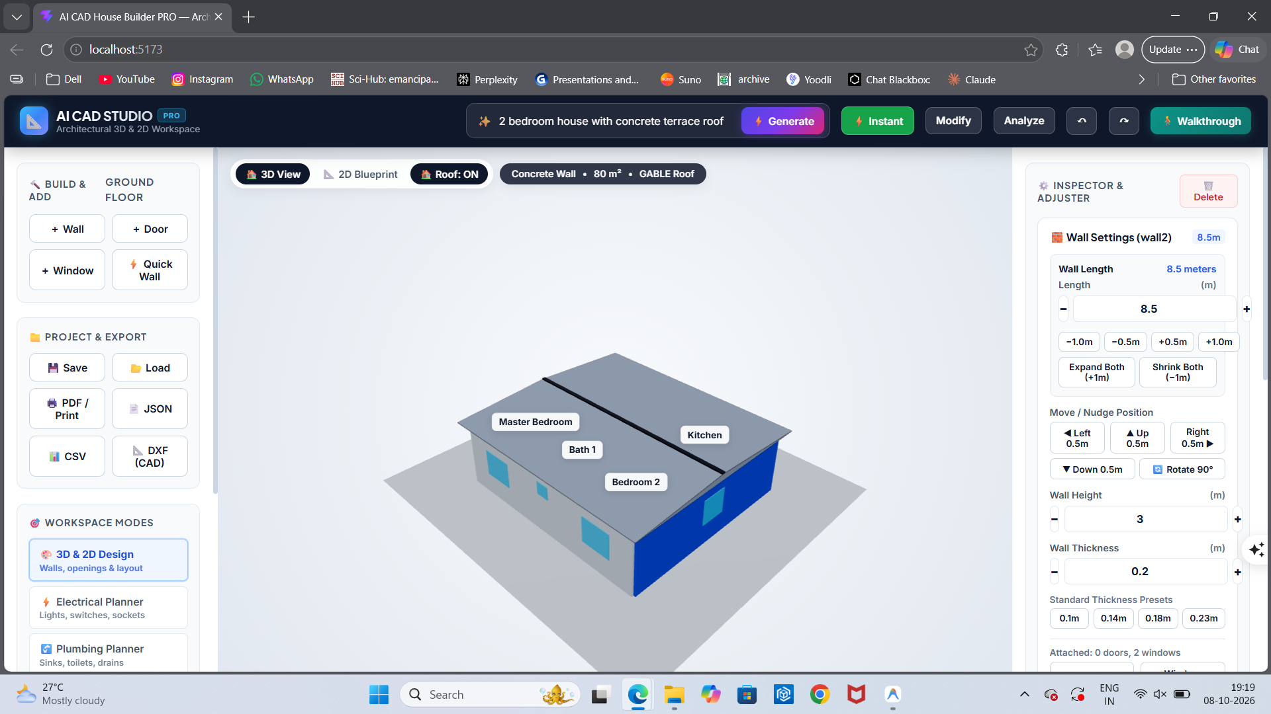
Prototype modules and workflow
1
Prompt and project setup
2
AI generation
3
2D floor plan
4
3D viewer
5
Object editing
6
AI modification
Generated 2-bedroom house, wall selected in the inspector
7
Walkthrough
Notes:
Prototype modules and screenshot of the running UI.

Slide 12
Technology stack
Layer | Technology | Role
Frontend | React 19, Vite | Web interface and workflow
3D | Three.js, React Three Fiber, Drei | 2D plan and 3D scene, walkthrough
AI | Qwen 2.5 7B Instruct, Q4_K_M | Planner (llama.cpp target, Ollama today)
Backend | Python, FastAPI | Generate, modify, analyze, health
Storage | Browser localStorage, JSON file | Save and load, no database yet
CAD | JSON model, basic DXF | Structured representation, line export
Deployment | Local only | Offline, three services on one machine
Notes:
Technology stack. Backend currently calls Ollama; the target deployment is llama.cpp.

Slide 13
Literature survey and research gap
Theme | Examples | Typical focus | This work
NL to CAD | Text2CAD, CAD-Llama, Text-to-CadQuery | Part-level CAD sequences | Whole-house CAD
LLM CAD agents | CAD-Assistant, TOOLCAD | General tool-using CAD | Architecture-specific tools
Validation | CADCodeVerify, CADFusion | Verify and refine outputs | Checks before execution
Floorplans | House-GAN++, HouseDiffusion, HouseMind | Layout generation | Editable persistent model
RESEARCH GAP: few systems combine
Natural language
Tool-validated ops
Editable 2D / 3D
Iterative AI edits
Notes:
Literature survey grouped by theme; limitation column describes typical focus, not a claim about every paper.

Slide 14
Benefits, extensions and plan
ADVANTAGES
FUTURE SCOPE
EVALUATION
Lower CAD learning curve
Fast concept generation
Easy modification
Interactive 3D view
Runs locally and offline
Multi-floor support
DWG and STEP export
BIM integration
Furniture generation
Voice-controlled CAD
Run T1 to T7 with three baselines and report measured results, not simulated ones.
Done
Next
Then
Finally
Prototype UI + AI endpoints
Tool layer
Validator + retry
Experiments + paper
Notes:
Advantages, future scope and development plan.

Slide 15
Conclusion
AI-CAD House Builder lets users state design requirements in plain language and get a validated, editable model they can explore in 2D and 3D.
Natural language
Local LLM
CAD geometry
Describe it. Generate it. Walk through it. Edit it.
3D and editing
Thank you
Notes:
Close with the contribution and thank-you.

